Slide 1
OENG 1117 RISK and Project Management
Course overview and Risk Management
Course Coordinator/Lecturer: Dr Lei Hou
Lei.hou@rmit.edu.au

Slide 2
Generally, there are four main characteristics of a project, regardless of its size and complexity.
The first is that a project has a definite start and end date.
The second is that it achieves a goal or an outcome.
The third to consider is that a project provides benefit or value to the recipient.
Finally, a project requires an allocation of resources that need to be skillfully used.

Slide 3
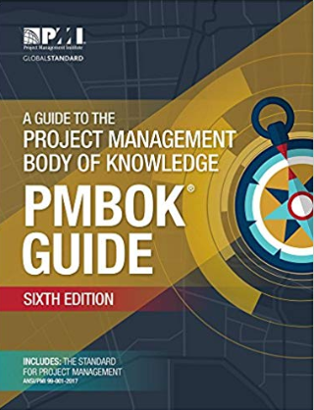
Project Management Body of Knowledge
1. Integration Management
2. Scope Management
3. Schedule Management
4. Cost Management
5. Quality Management
6. Resource Management
7. Communications Management
8. Risk Management
9. Procurement Management
10. Stakeholders Management

Slide 4
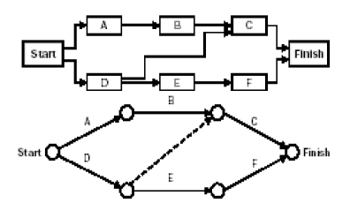
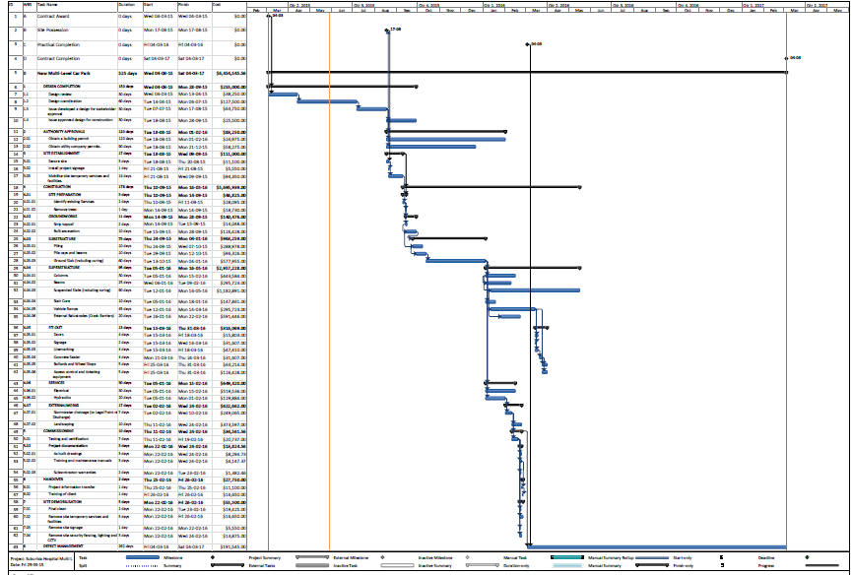
Time management
Network Diagrams
Gantt Chart

Slide 5

Procurement management
Procurement management is the processes required to acquire goods and services which ultimately require to produce the output (project/ product)
Buyer-seller relationship
1. Procurement planning
2. Solicitation planning
3. Solicitation
4. Source selection
5. Contract administration
6. Contract close-out
Buyer
Seller
Contractor
Vendor/ supplier
Project team

Slide 6
Communication management
Effective communication
Timely reporting
Project success
Project communication management includes the processes required to ensure timely and appropriate project information including their:
Generation
Collection
Dissemination
Storage and
Disposal
1.Communication planning
2. Information distribution
3. Performance reporting
4. Administrative closure

Slide 7


Risk management
Engineers invent and produce, the process of which involves risks.
A “good” engineering concept may lead to business bankruptcy.
Need, Concept, Design, Production and Market
Single dimension to multiple dimensions
More and more work has been accomplished through the use of projects and project management
Career: managing or being managed.
“When we promoted him, we lost a good engineer and gained a bad manager”

